Slide 1
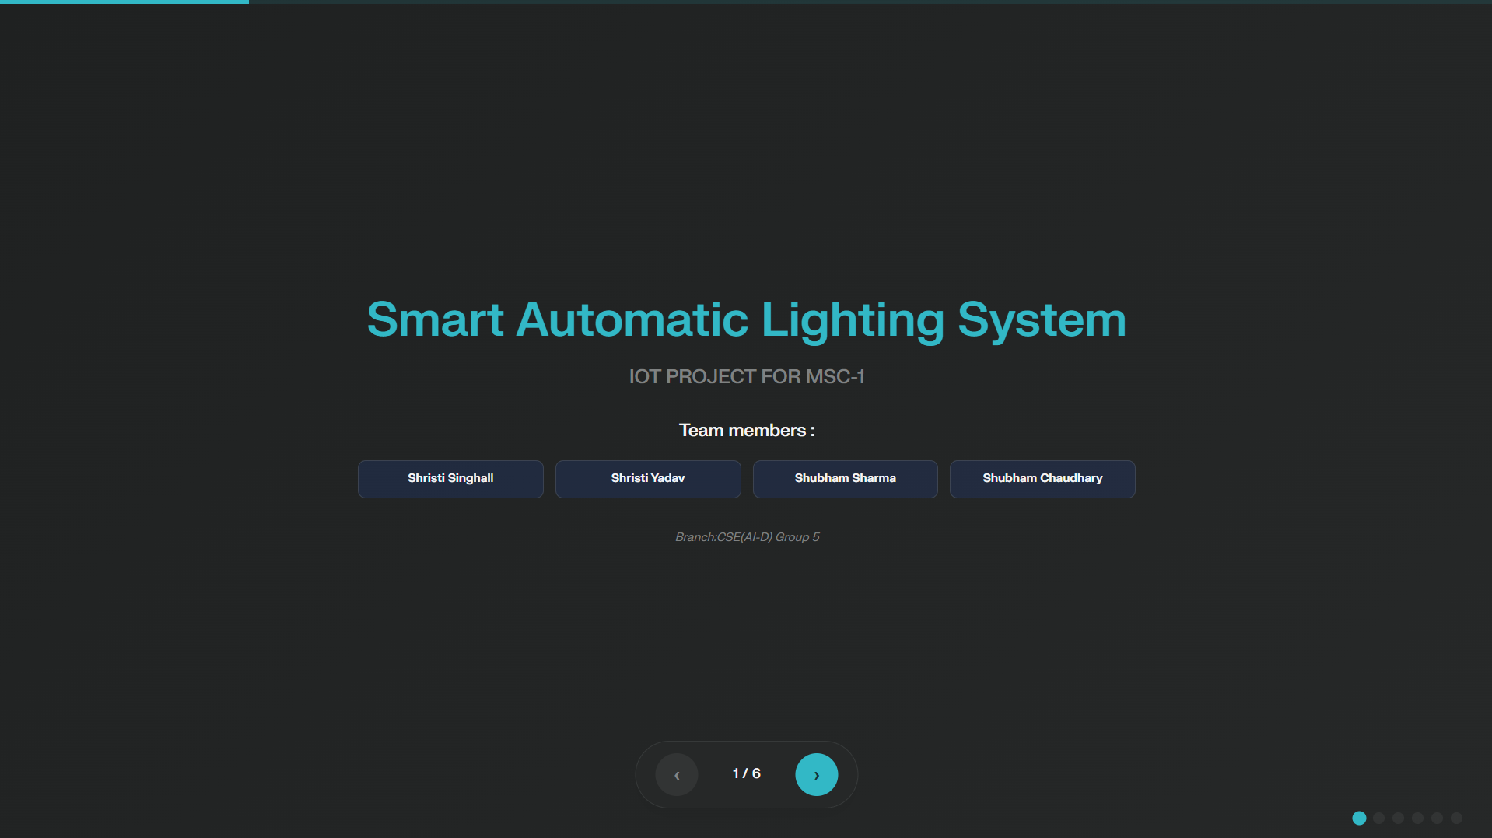
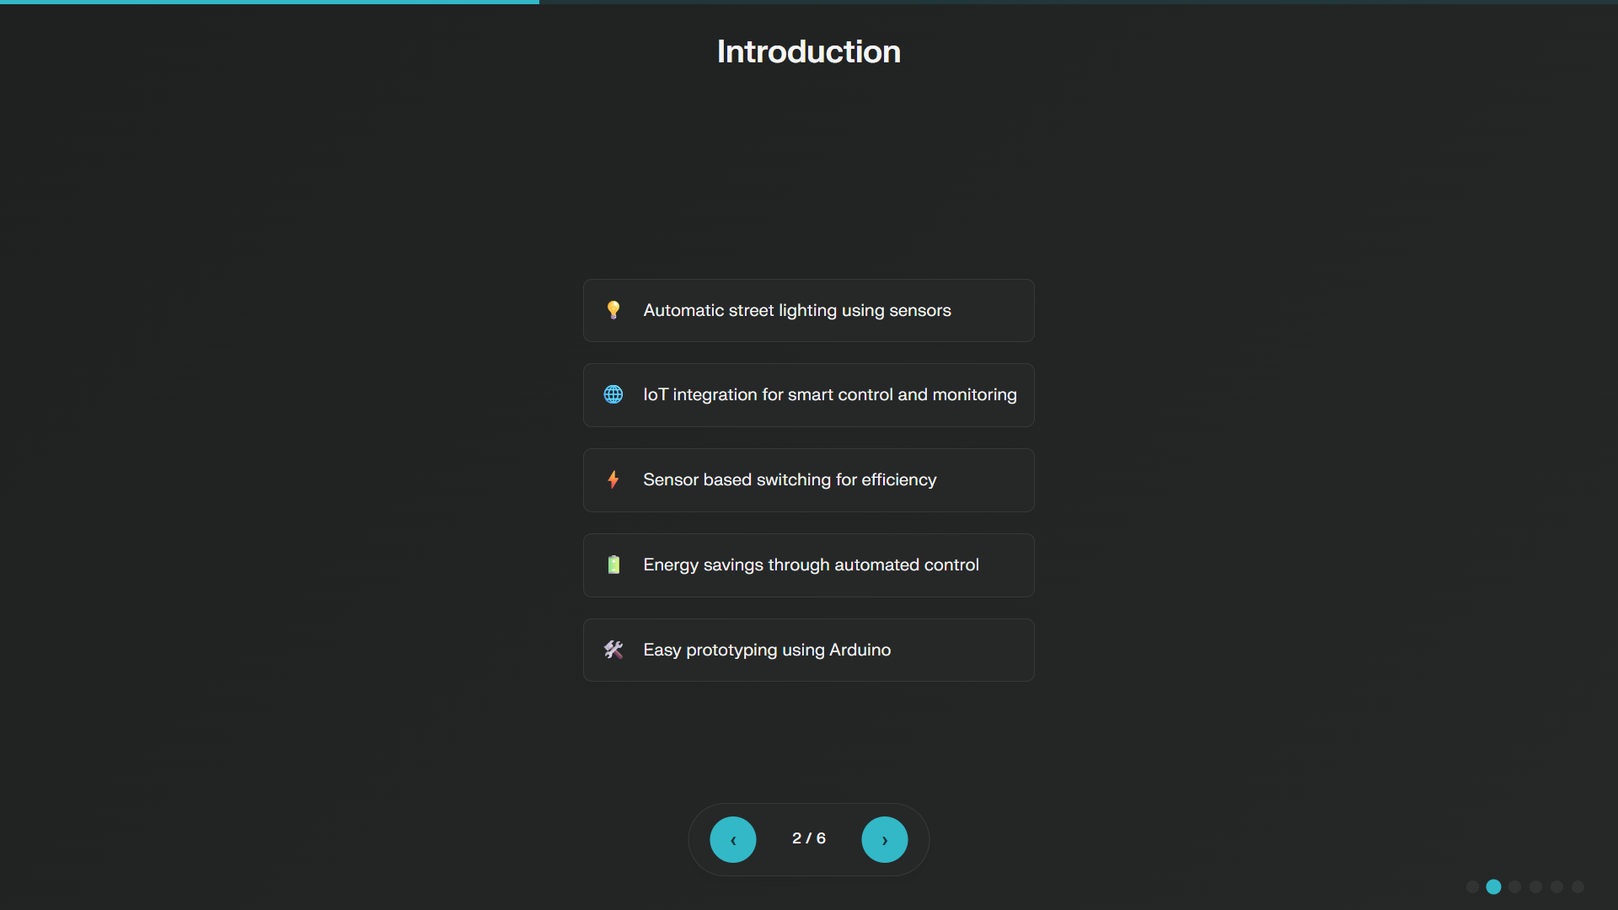

Slide 3
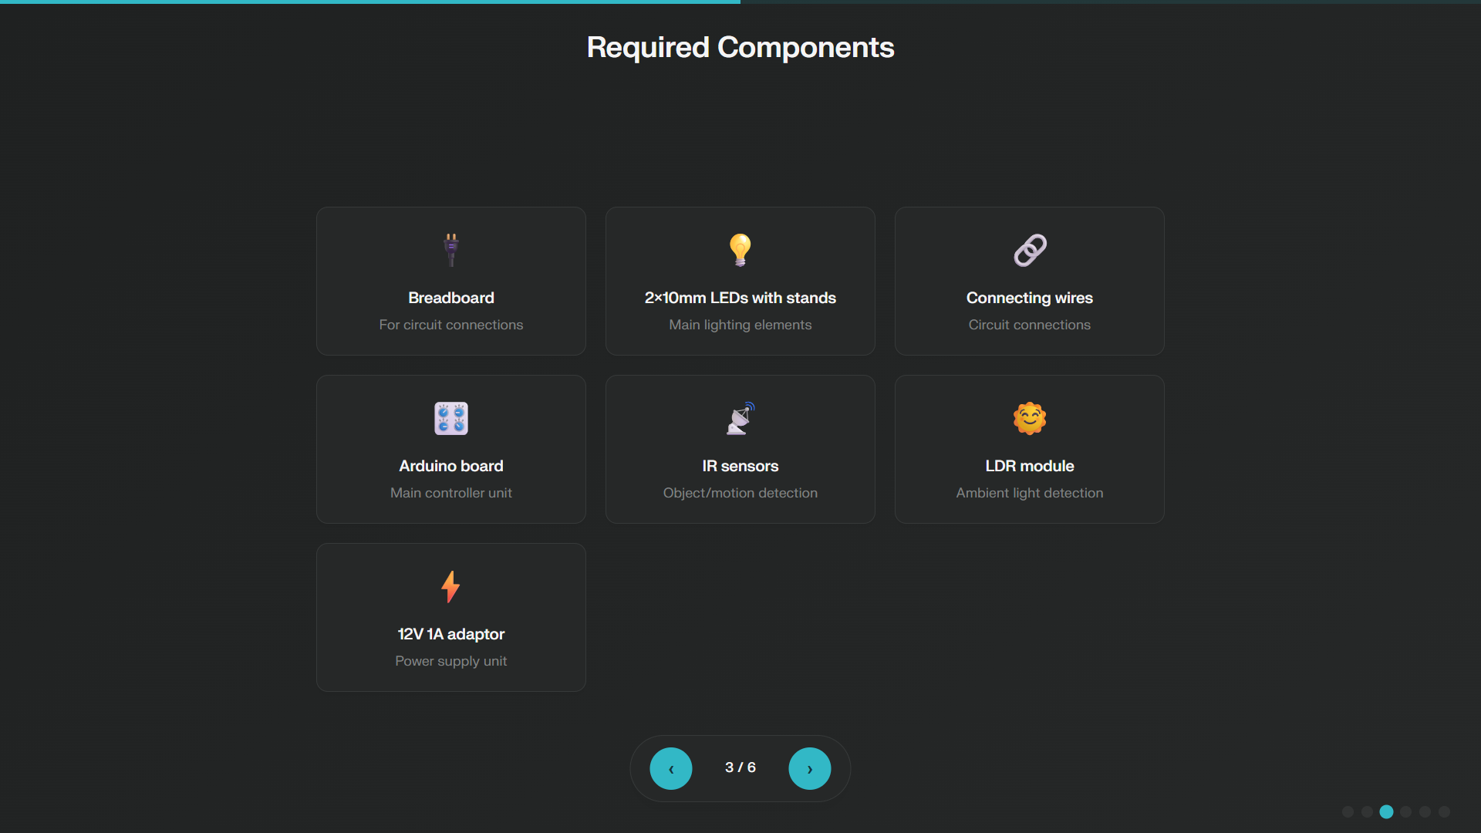

Slide 4
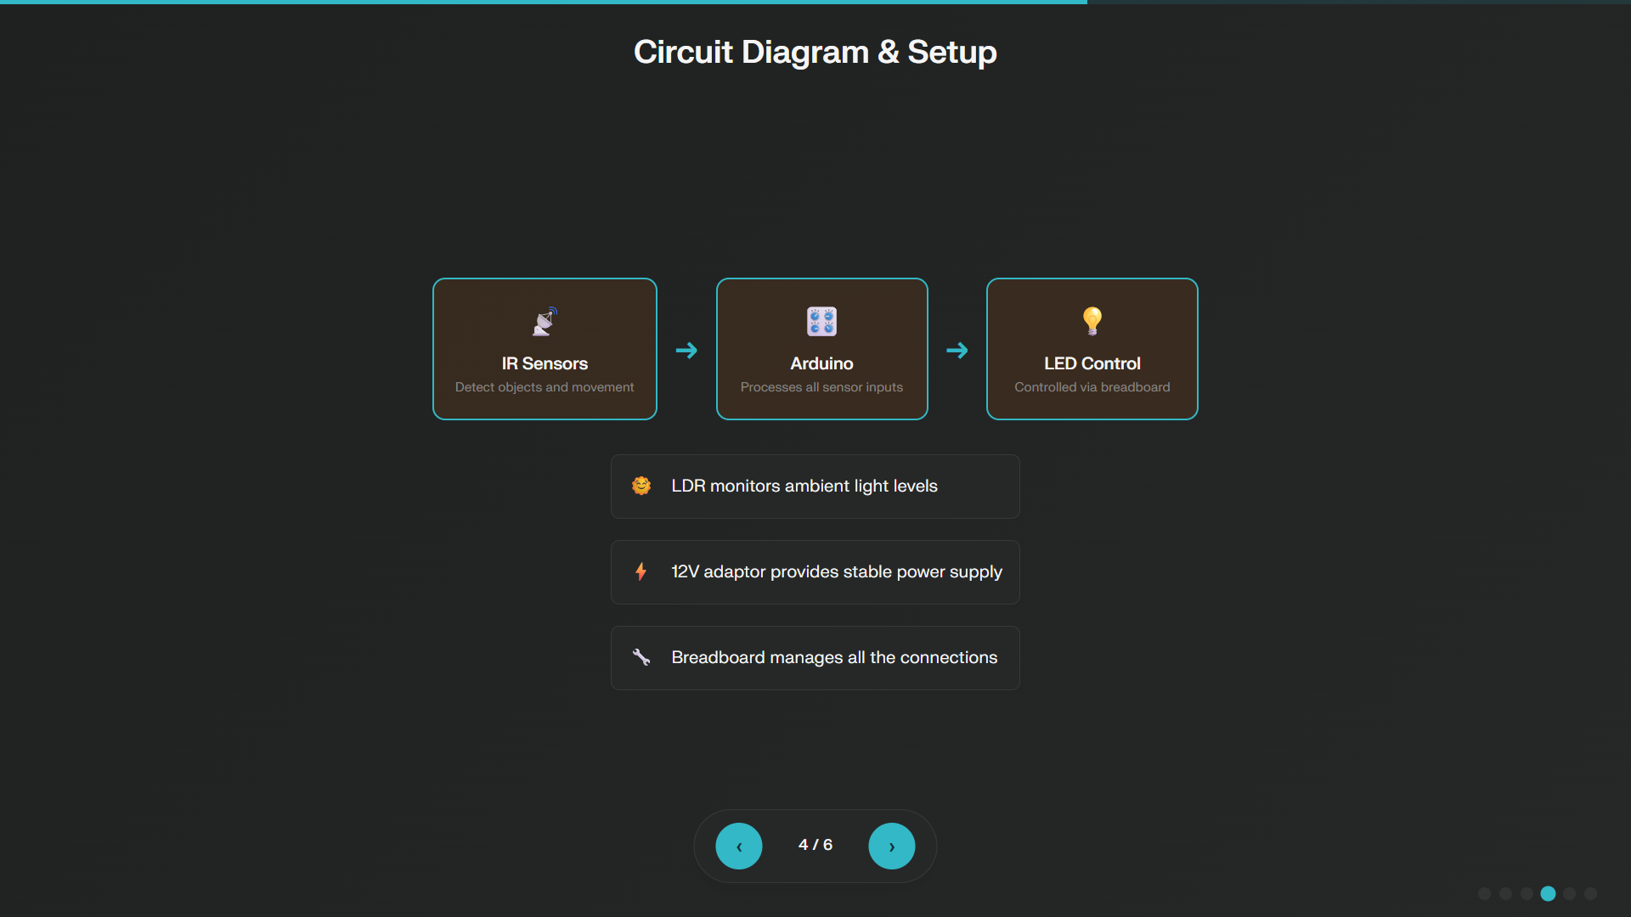

Slide 5
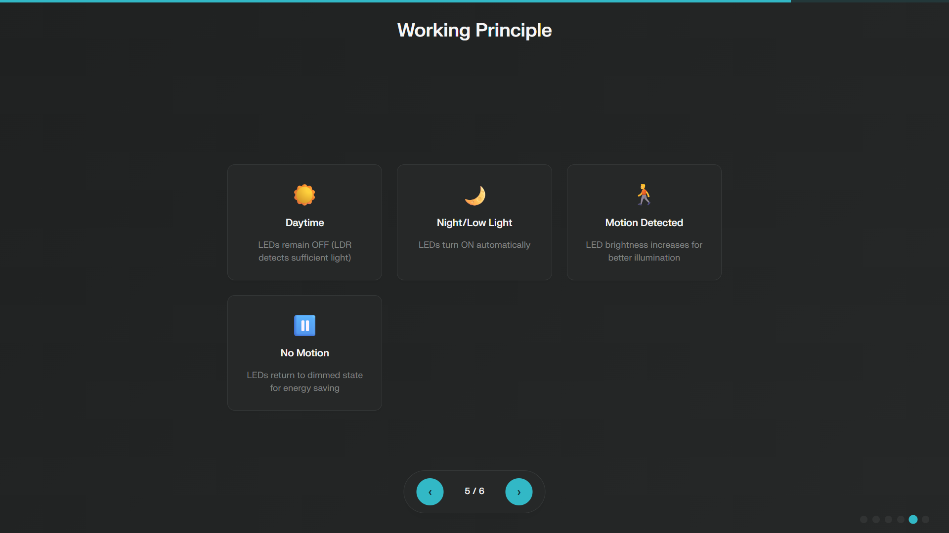

Slide 6
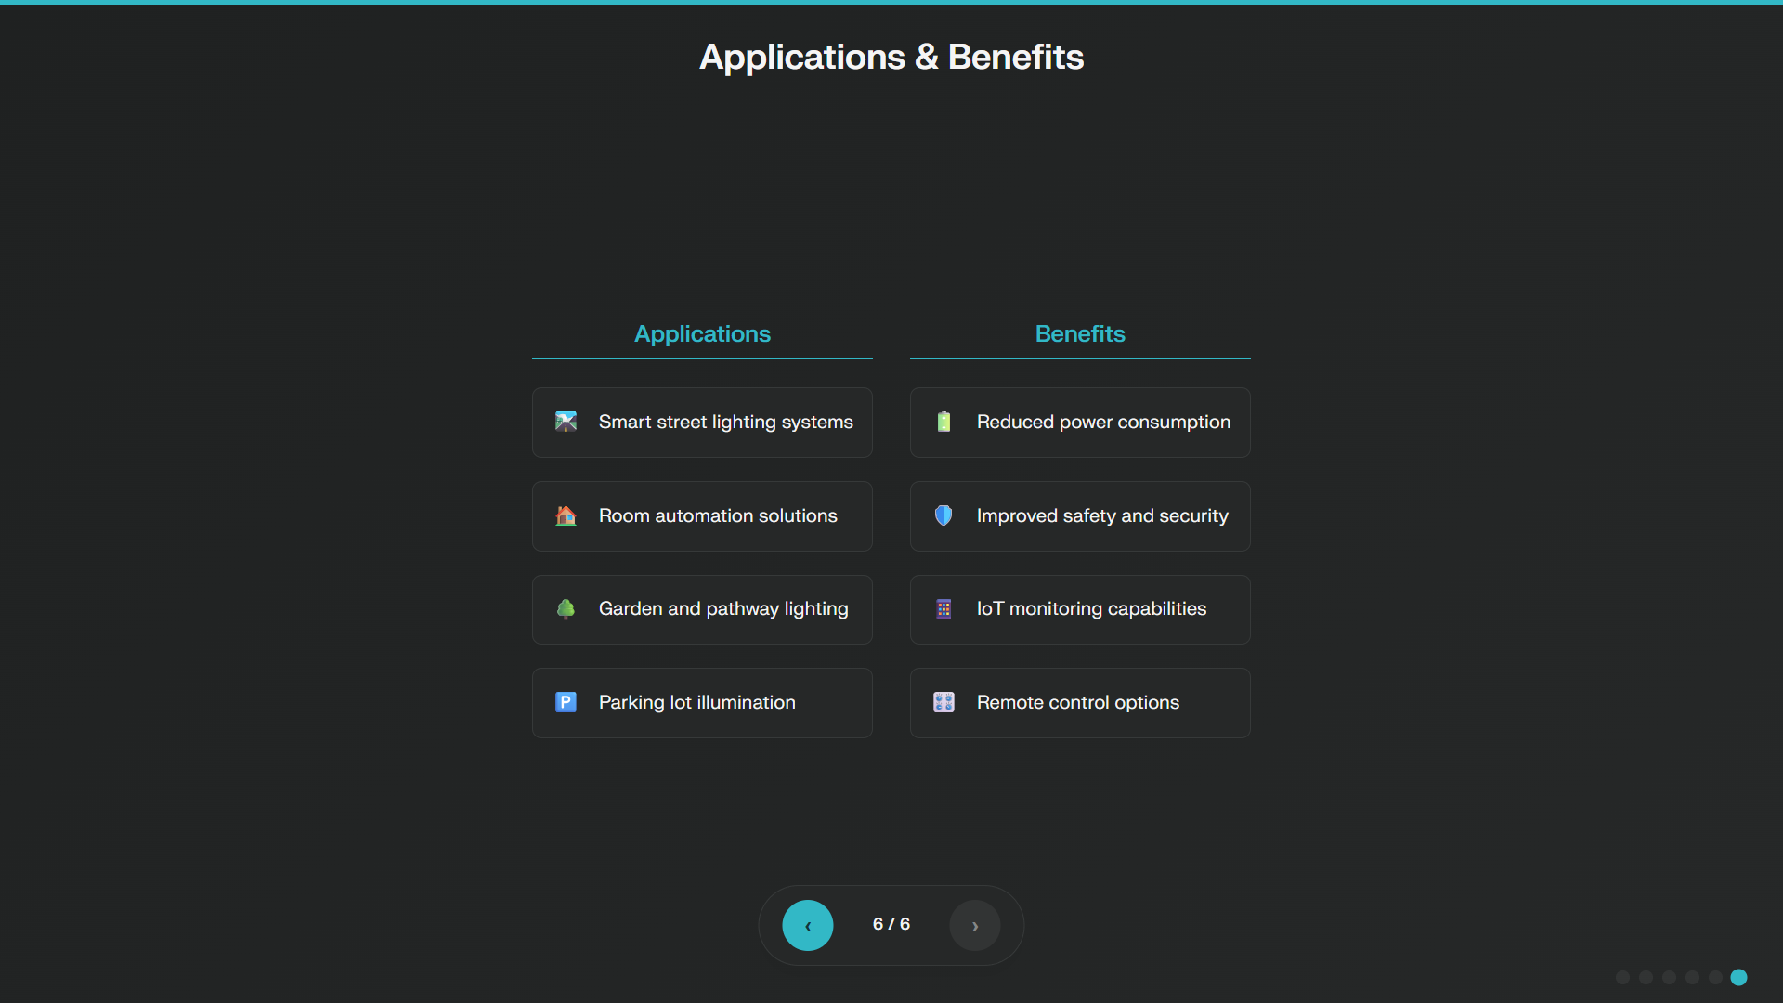

Slide 7
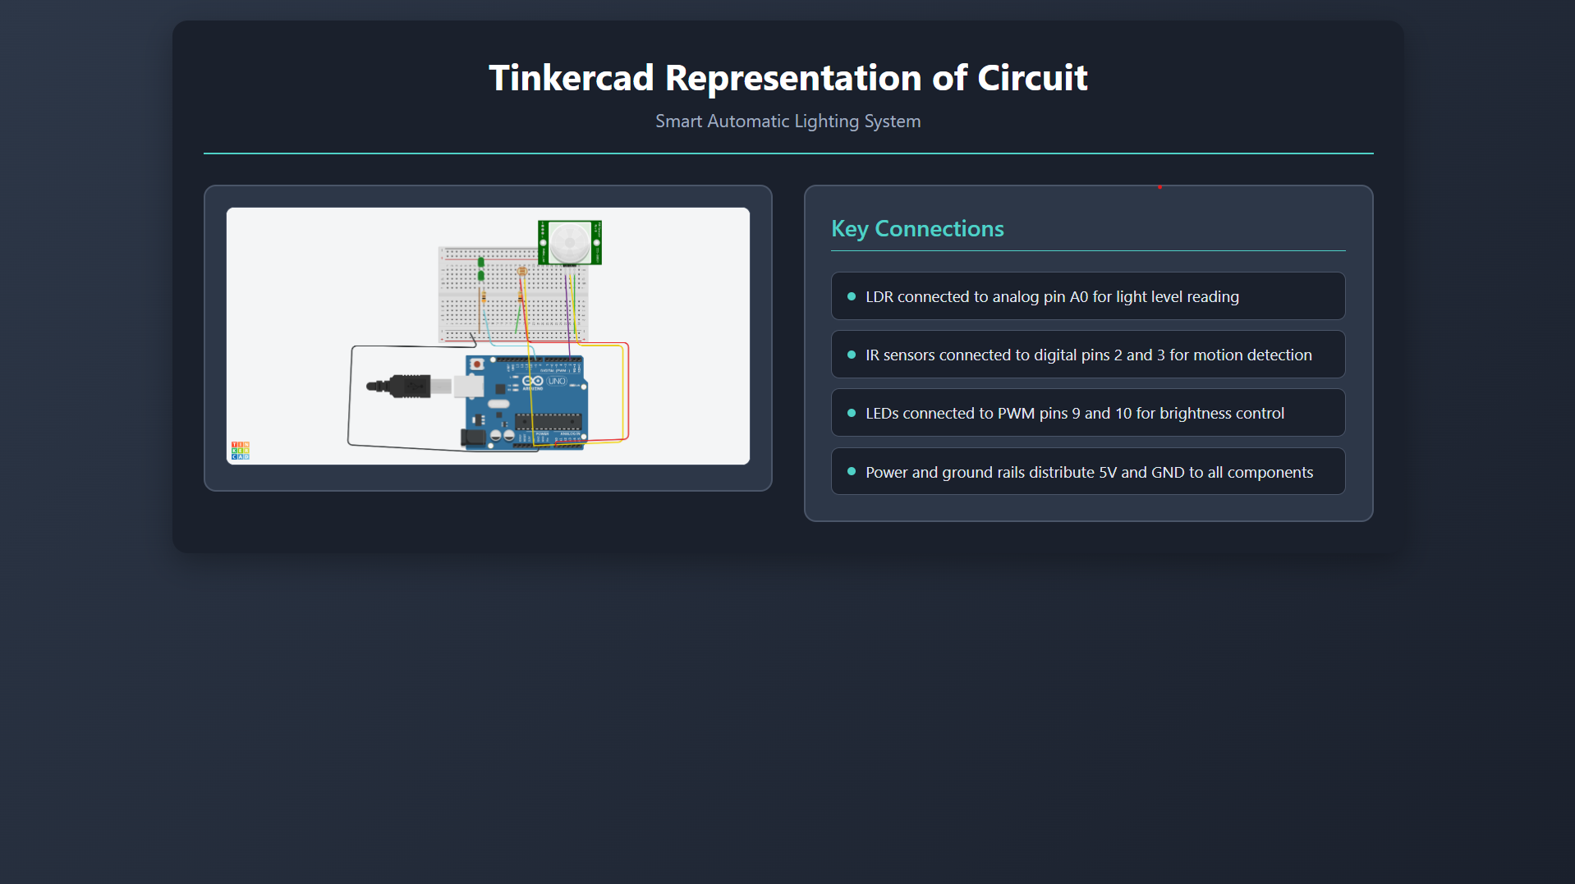

Slide 8
Research Findings & Analysis
Smart Automatic Lighting System
Energy Efficiency Performance
• 35-87% energy consumption reduction
• 80% savings in warehouse implementations
• 50-70% reduction in residential applications
• Average payback period: 0.8-5 years
Technical Specifications
• Detection Range: Up to 20 meters
• Response Time: Near-instantaneous
• Communication: LoRa, Zigbee, Wi-Fi
• LED Lifespan: 25-50x longer
Real-World Case Studies
🏢 Montreal Smart Lighting
132,000 fixtures → $3.7M annual savings
🏢 Cambodia LED Project
12,000 streetlights → 559 tons CO2 reduction
🏢 Las Condes, Chile
17,000 connected lights → Traffic monitoring
🏢 Warehouse Implementations
80% consumption reduction achieved
Advanced IoT Features
CMS • Mobile Control • Predictive Maintenance • Environmental Sensors • Traffic Analysis

